Slide 1
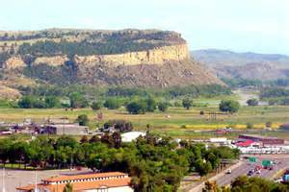
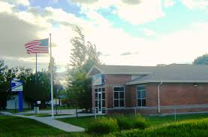
Proposed Lockwood
Targeted Economic Development District
Yellowstone
County
2015

Slide 2
Our Presentation
Our schedule of activities for this visit
Overview of Targeted Economic Development Districts and Tax Increment Financing
Phase 1 Activities
  Boundary Discussion
  Identification of Infrastructure Deficiencies
Phase 2 Activities – The Next Steps
District Management
Questions

Slide 3
Summary Schedule
Yesterday
8:30 A.M. – Site Tour
2:00 P.M. – Presentation and Discussion with the County Commissioners
4:00 P.M. – Utilities Working Group @ Lockwood Water & Sewer District
7:30 P.M. – 1st Public Meeting @ Lockwood Middle School Commons Area
Today:
9:00 A.M. – Meeting with Lockwood Taxing Entities @ Lockwood Water & Sewer District
12:00 P.M. – 2nd Public Meeting @ Weave Management 2348 North Frontage Road
6:00 P.M. - Lockwood School Board Meeting
6:00 P.M. – Yellowstone County Planning Board (Presentation will be about 8:00 p.m.)

Slide 4
What are Targeted Economic Development Districts?
Targeted economic development districts assist communities in addressing infrastructure deficiencies in order to support the retention, expansion and location of value-adding businesses and industries
Tax Increment Financing or “TIF” is a funding mechanism which can be used to help fund public infrastructure and associated services in Targeted Economic Development Districts (TEDDs)
A TEDD creates a partnership with private industry to address the needed public infrastructure that then supports private investment.

Slide 5
What is Tax Increment Financing?
TIF is authorized under 7-15-4282, MCA and enables communities to direct property taxes from new development within a designated infrastructure-deficient geographic area to various public development activities. A base year is established from which incremental increases in property values are measured

Slide 6

How a Tax Increment Finance Provision Would Work
TIF End Date
TIF Start Date
Tax Value for Distribution
Taxable Value
Increment for Development
Base + Increment
BASE
Impeded Growth
Tax Value for Distribution
Time

Slide 7
How are taxing jurisdictions affected?
Each taxing jurisdiction continues to receive property taxes levied against the TEDD’s base taxable value.
The area that is being considered for inclusion in this TEDD currently generates $60,170.34 per year in taxes. (Based on 4 potential anchor tenants in proposed TEDD)
Only the incremental tax dollars received from new development are placed in a separate fund for making public improvements within the TEDD for 15 years.
How is the current $60,170.34 in tax receipts distributed?
$13,839.18 – General Fund
$13,839.18 – Lockwood Fire
$8,423.85 – State Education Fund
$6,017.03 – Billings School District #2 (High School)
$4,211.92 – County Retirement and Transportation
$601.70 – Big Sky EDA
$13,237.47 – Lockwood Schools

Slide 8

Public/Private Partnership Agreement
Private investment
  Assume: $2,000,000 dollars of appraised NEW value
  Assume: Class 4 property (residential, commercial, industrial) @2.20% (2015) = $44,000 in taxable value.
  Assume: A mill levy of 721.78 (Total mill levy for Lockwood, less the 6 mill university levy)
Tax Increment = $31,736.00 (available for infrastructure investment)

Slide 9
The Bigger Picture
Countywide, the total taxable value is $307,664,072.
The amount of the new taxable value in TIF districts is $6,713,800, or 2.18% of the County’s 2014 total taxable value.

Slide 10

There is No Financial Effect on
Individual Property Owners!
The TIF provision ONLY affects the WAY in which new property tax dollars (based on new value) are distributed.
As always, taxes paid are based on the value of your property including new improvements.
Property owners, benefit, however, because infrastructure improvements are made in the area in which their properties are located.

Slide 11
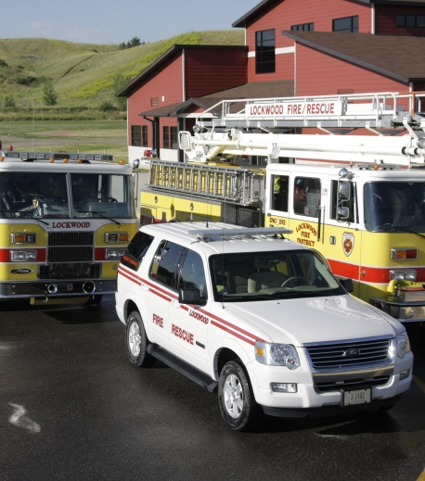
Long Term Benefit
When the district sunsets, for every $2,000,000 of new appraised value, the Lockwood schools and the Lockwood Fire District would each receive an additional $7,000 per year of new tax revenue.

Slide 12
Using Tax Increment Dollars
Expenditures based on existing cash
Debt financing
Leveraging funds from other sources
Providing required matching funds
Revolving loan fund
Bridge funding

Slide 13

Allowable Uses of TIF Funds by Local Governments
Land and Infrastructure Development
  Roads
  Rail Services
  Sewer, Water and Stormwater Drainage
  Utilities
  Land improvements and Site Preparation
  Connecting to Services Outside the District
Public Services
Business and Technical Assistance Programs

Slide 14
Remember: TIF is only one of Several Tools!
State and Federal Loans and Grants
Special Improvement Districts
Public-Private Partnerships
Developer Financed Infrastructure Improvements

Slide 15

Steps in Creating a TEDD with a TIF Provision

Slide 16
Phase 1: Program Initiation (this visit - ✔)
Identify a concept area for consideration. ✔
Meet with affected taxing jurisdictions to provide information and seek input on the proposed TEDD ( school districts, fire districts, etc.) ✔
Prepare a preliminary boundary map of the proposed district. ✔
Prepare a Resolution of Necessity with a corresponding Statement of Infrastructure Deficiency for adoption by the County Commission

Slide 17
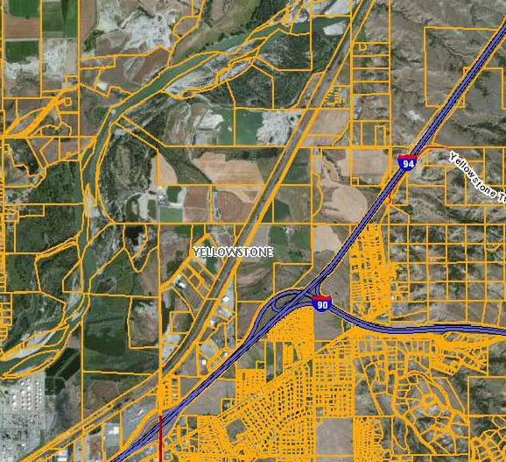
Lockwood Area of Consideration
North of the Interstate
South of the Yellowstone
River
East of Johnson Lane
West of the Planning
Jurisdictional Extent

Slide 18
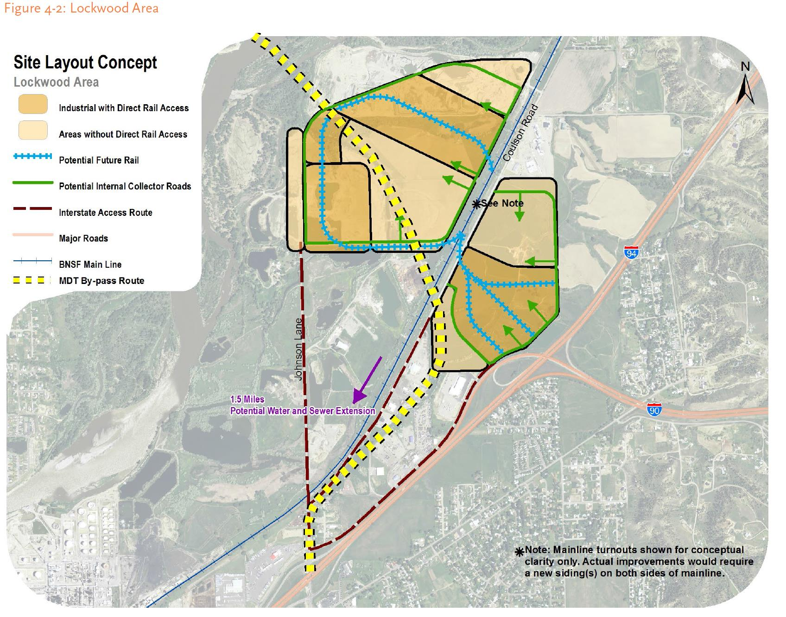
Lockwood Concept Area
We need your Input on
what property should
be included.

Slide 19
Phase 2: Comprehensive Development Plan
Prepare the Plan (with public and agency input) for the TEDD noting infrastructure deficiencies and planned activities that includes:
  A TIF Provision
  Infrastructure Deficiencies and Priorities
  Types of Value Adding Businesses that will occupy the TEDD
  Special programs or Infrastructure projects to be pursued
  Program administration
  Funding Strategies

Slide 20
Growth Policy Review – Planning Board Recommendation
Planning Board reviews the growth policy to recommend:
  That the Comprehensive Development Plan for the TEDD is in conformance with the adopted growth policy, and
  That the area of the TEDD is zoned in accordance with the adopted growth policy.
The Growth Policy should support the creation of a TEDD as follows:
  Existing Characteristics and Future Trends section addresses economic well-being
  Goals and Objectives support the development of secondary value-adding industries
  TIF identified as an implementation strategy
  Land Use maps support zoning designations

Slide 21
Current Industrial Zoning in the Lockwood Area

Slide 22
TEDD Adoption
Hold a public hearing on the TEDD plan following notification by mail of all property owners in the district and through the placement of a legal advertisement. (County Commission)
Adopt the ordinance creating the TEDD (County Commission)
Ordinance is effective 30 days after passage (before end of December of the base year)
Submit materials to the Montana Department of Revenue for Certification

Slide 23

TIF Program Management Options
May be managed by the County Commission
  Staff
  Management Contract
CC may choose to appoint a TEDD Advisory Board (not statutorily enabled, but often used for TIF districts)
Commission always has final budget authority

Slide 24

Questions and Discussion

