Slide 1
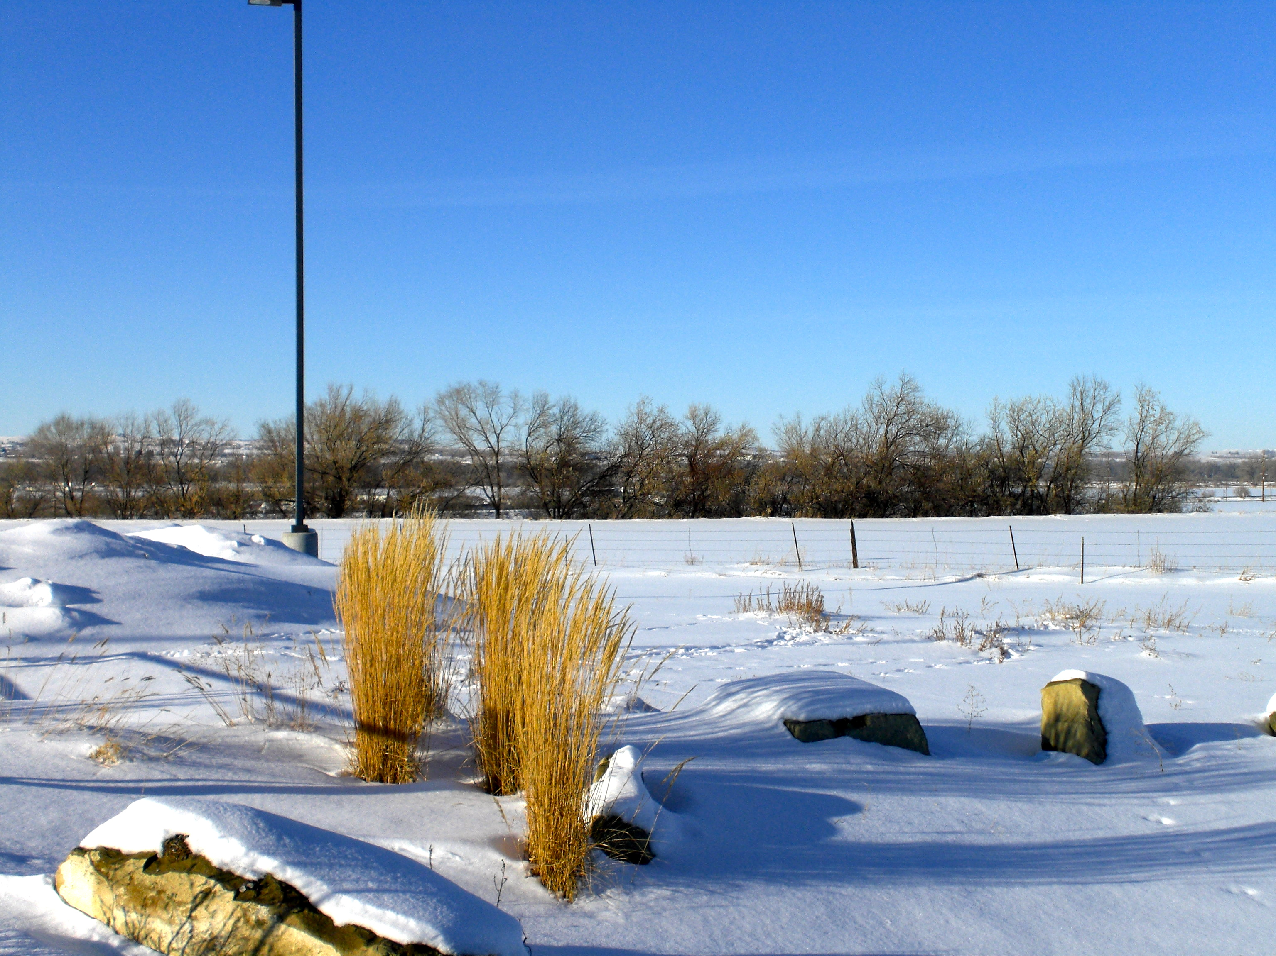
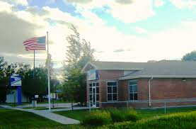
Lockwood Concept Area Targeted Economic Development District March 3rd, 2015 Yellowstone County Board of County Commissioners’ Regular Meeting
Yellowstone
County
2015

Slide 2
Today’s Presentation Overview
Introduction and Background
Project Steps and Progress to Date (Phase I)
Trailhead Commerce Park
Action to be Taken by the County Commission Today – Finding of Deficiency
Next Steps (Phase II)
Conclusion

Slide 3
Introduction and Background
BSED Strategic Priority
Pro-Opportunity
Regional Competitiveness
Industry Cluster Analysis and Marketing Plan (DCI, 2013)
Targeted Marketing Assistance Findings and Recommendations (Ady Voltedge, 2014)
Industrial Park Feasibility Analysis (KLJ, 2014)
Upstream and midstream oil and gas, manufacturing, warehousing, transportation and logistics are Yellowstone County’s leading industry growth opportunities.
—Industry Cluster Analysis and Marketing Plan (DCI, 2013)
Increasingly, readiness will be the basis upon which communities and regions compete.
—Janet Ady, President, Ady Voltedge (2014)

Slide 4
Steps in Creating a TEDD Phase I
Identify a study area that is appropriate for value-adding economic development projects.
Solicit public involvement and input.
Study the adequacy of infrastructure to support value-adding economic development.
Prepare a statement that addresses infrastructure deficiencies within the study area.
Adopt a Resolution of Necessity as required under 7-15-4280 MCA.

Slide 5
Lockwood Study Area
Pacific Steel & Recycling

Slide 6
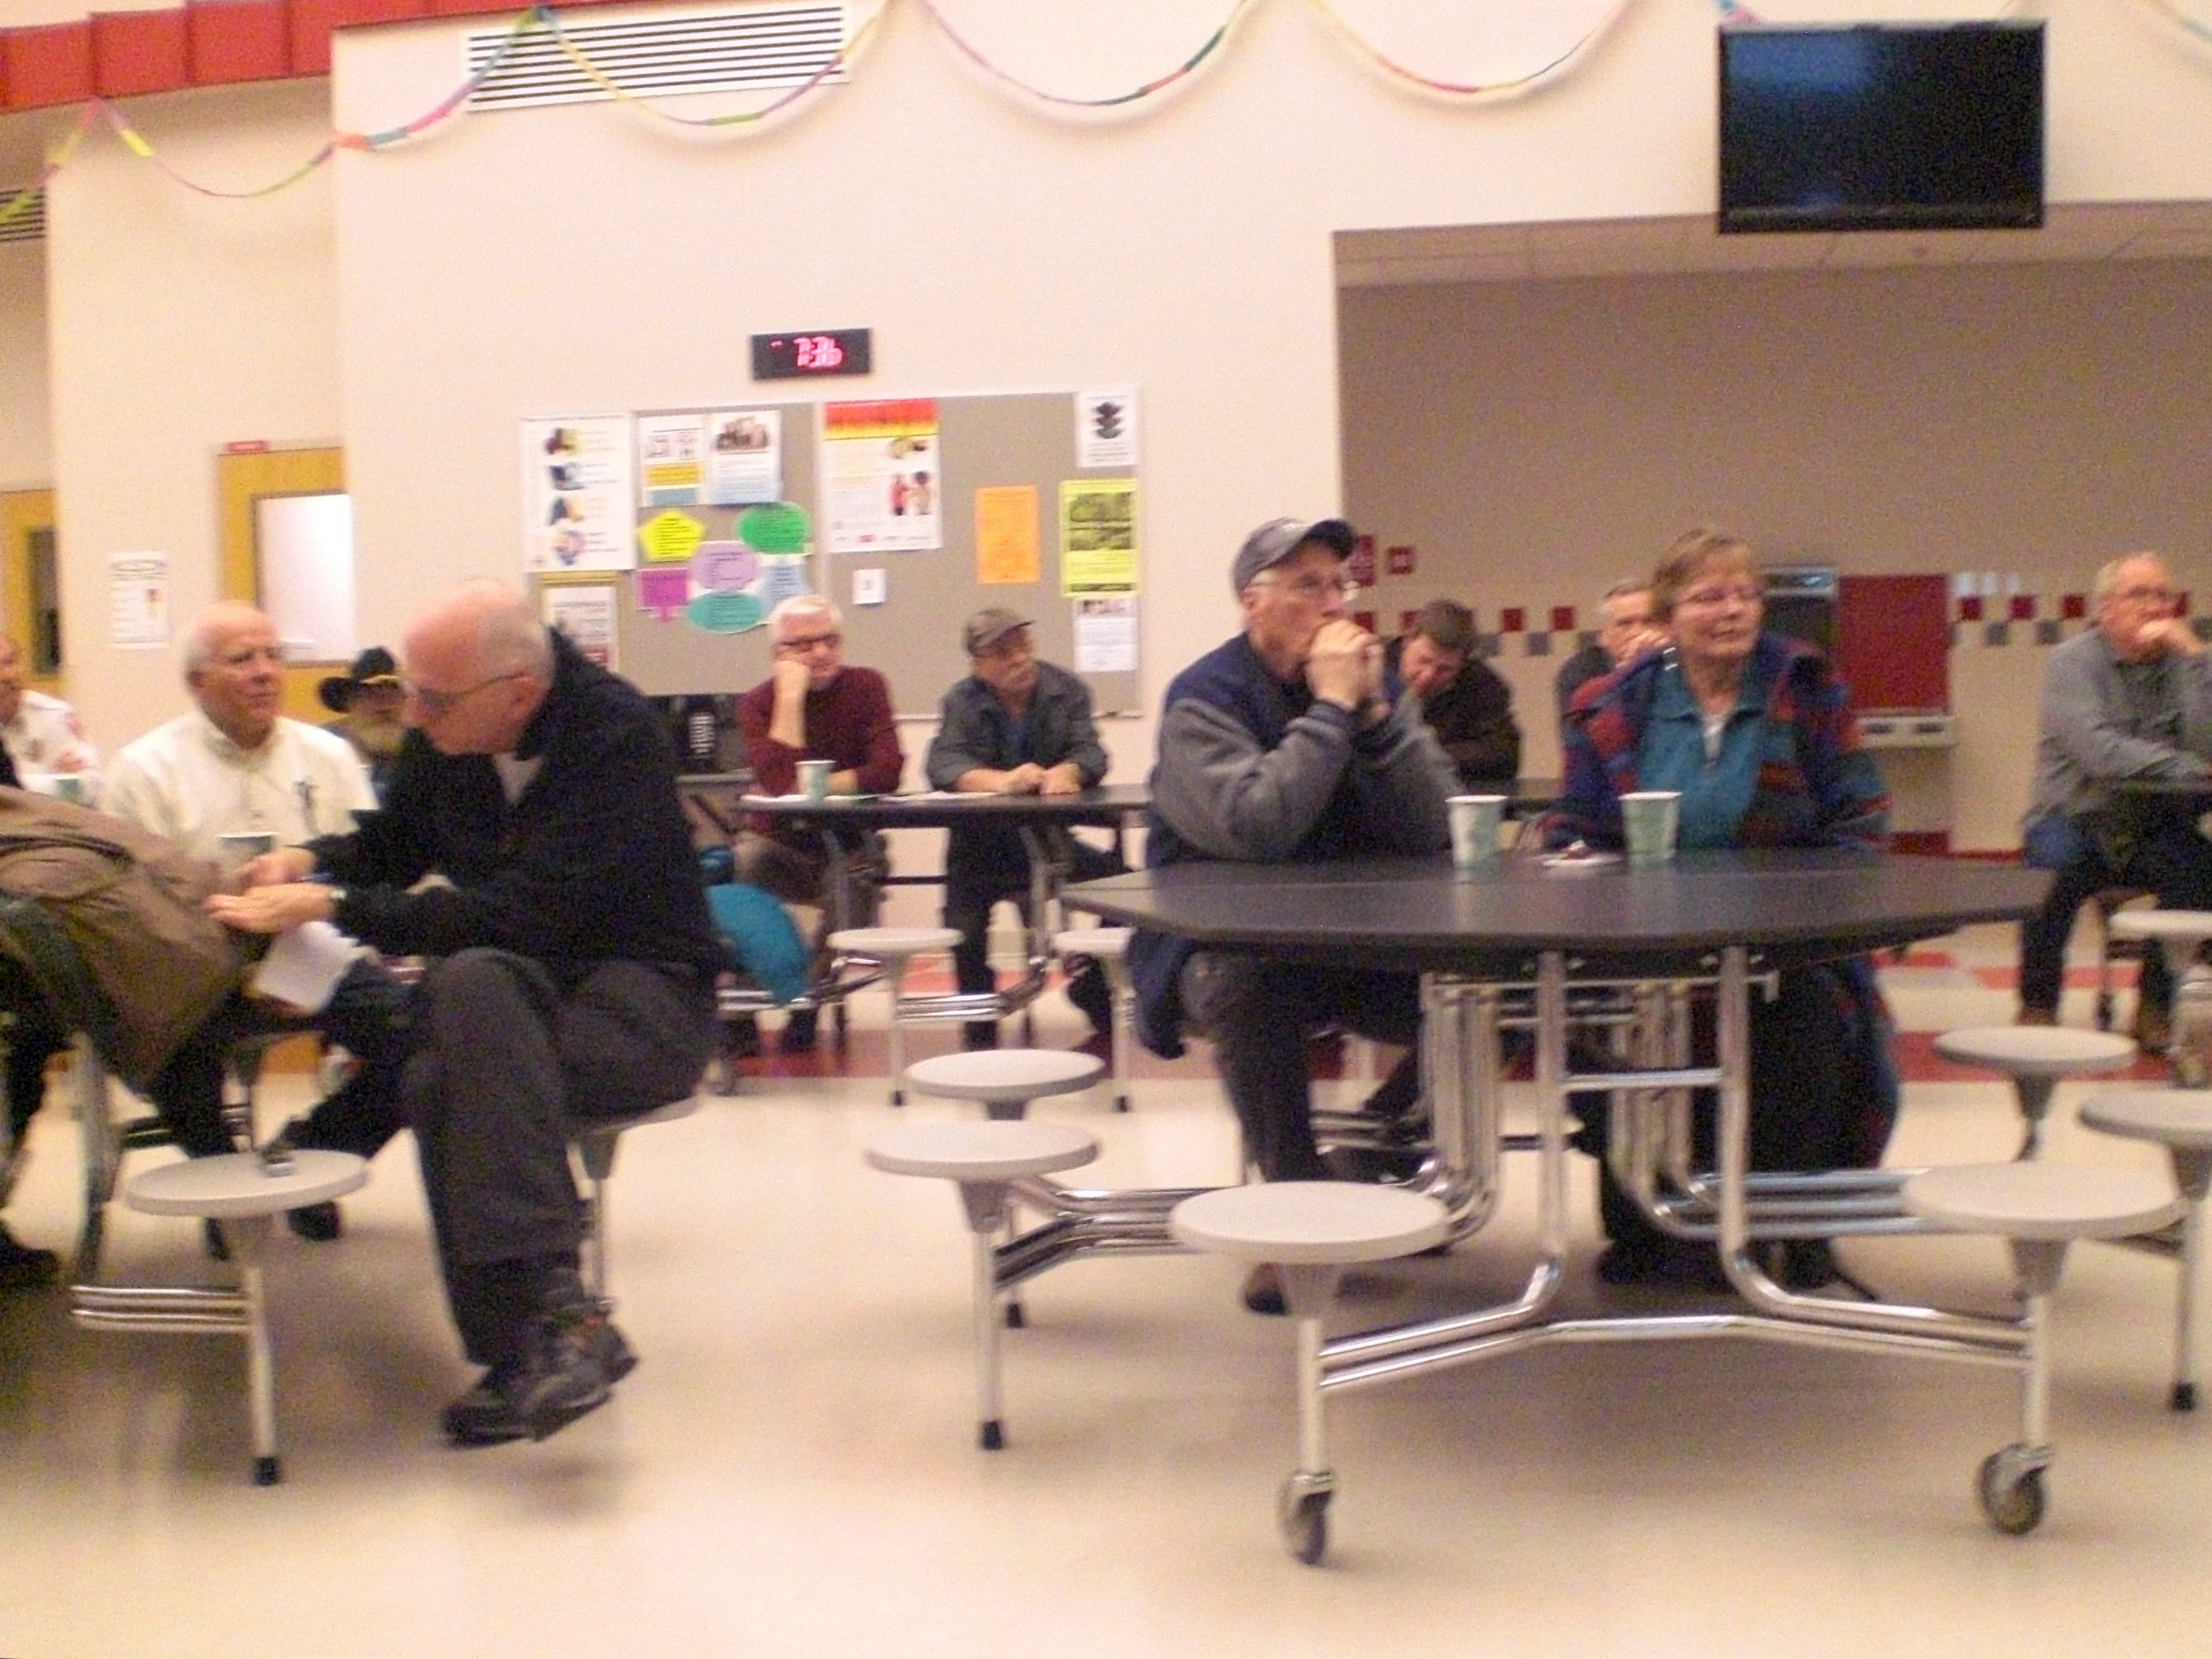
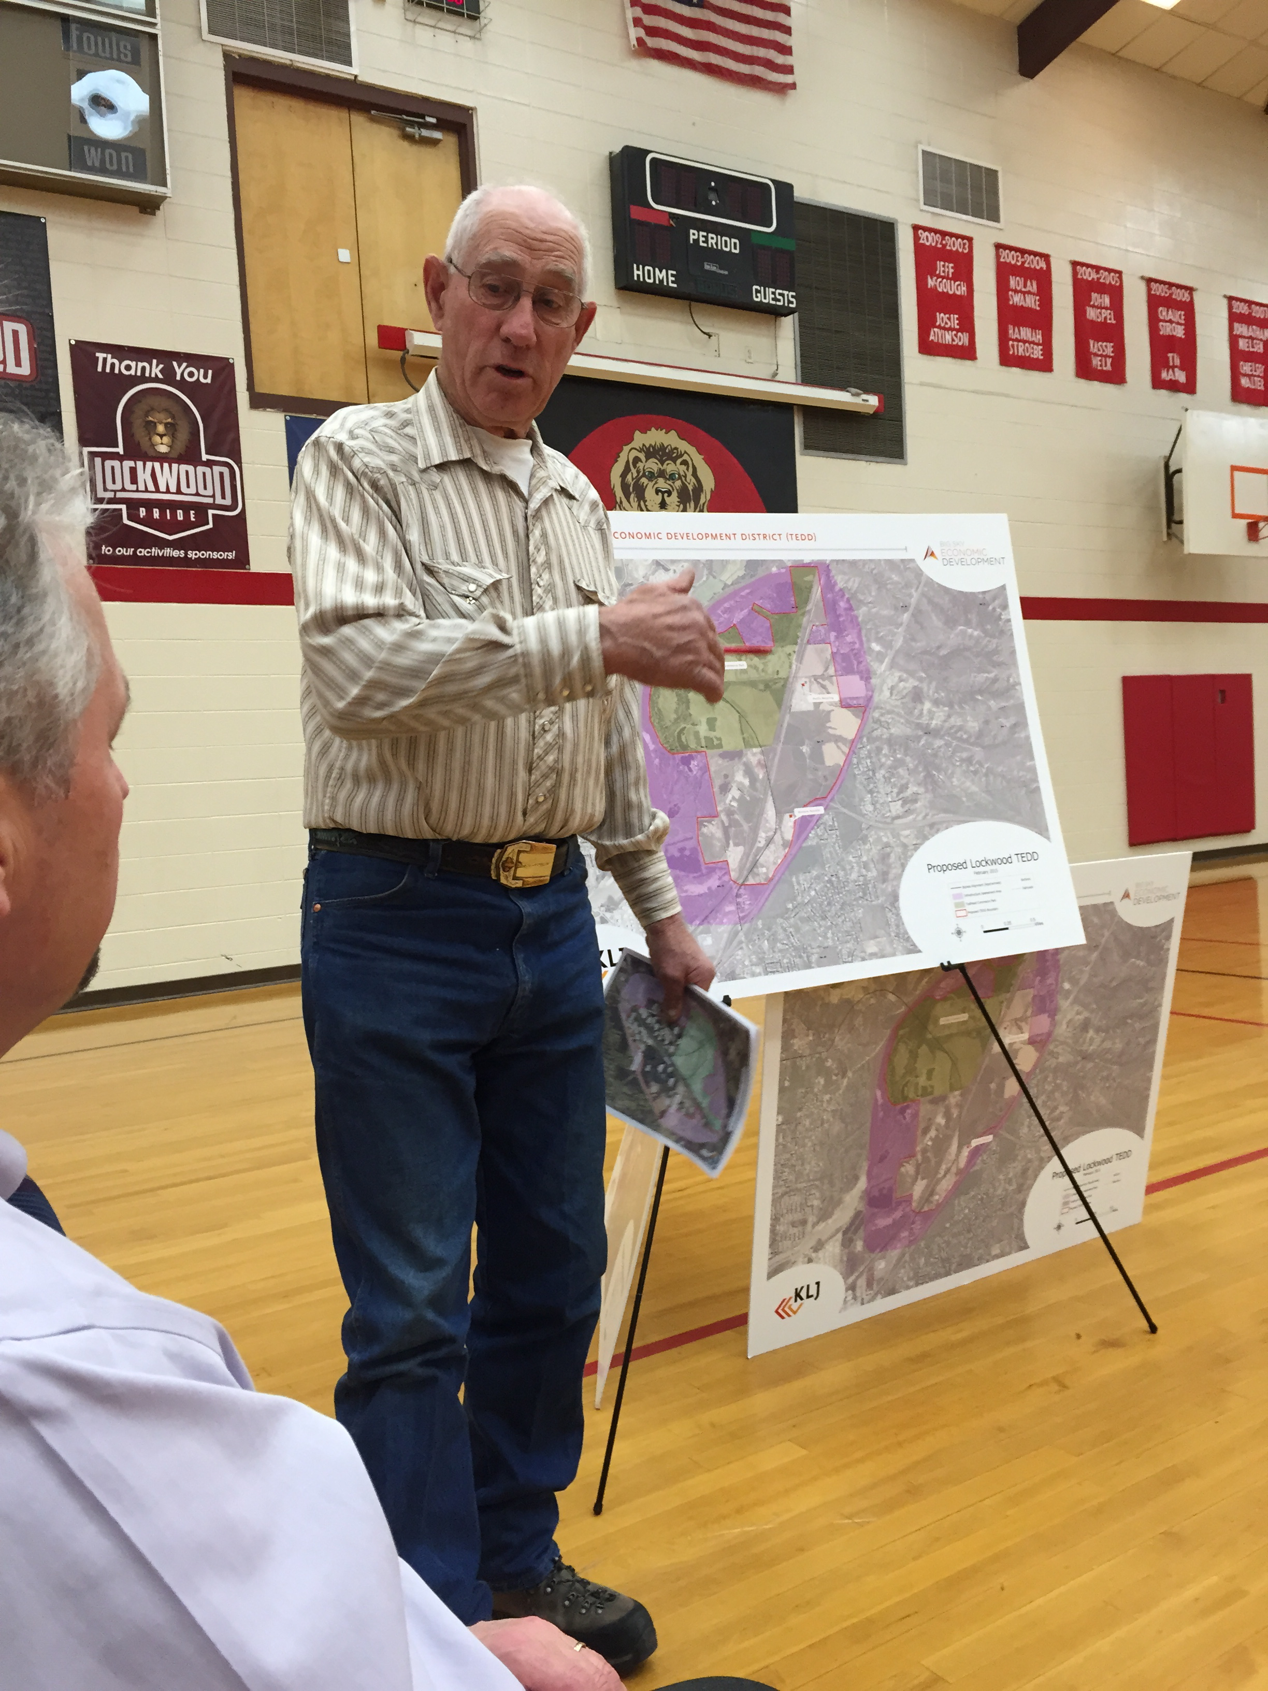
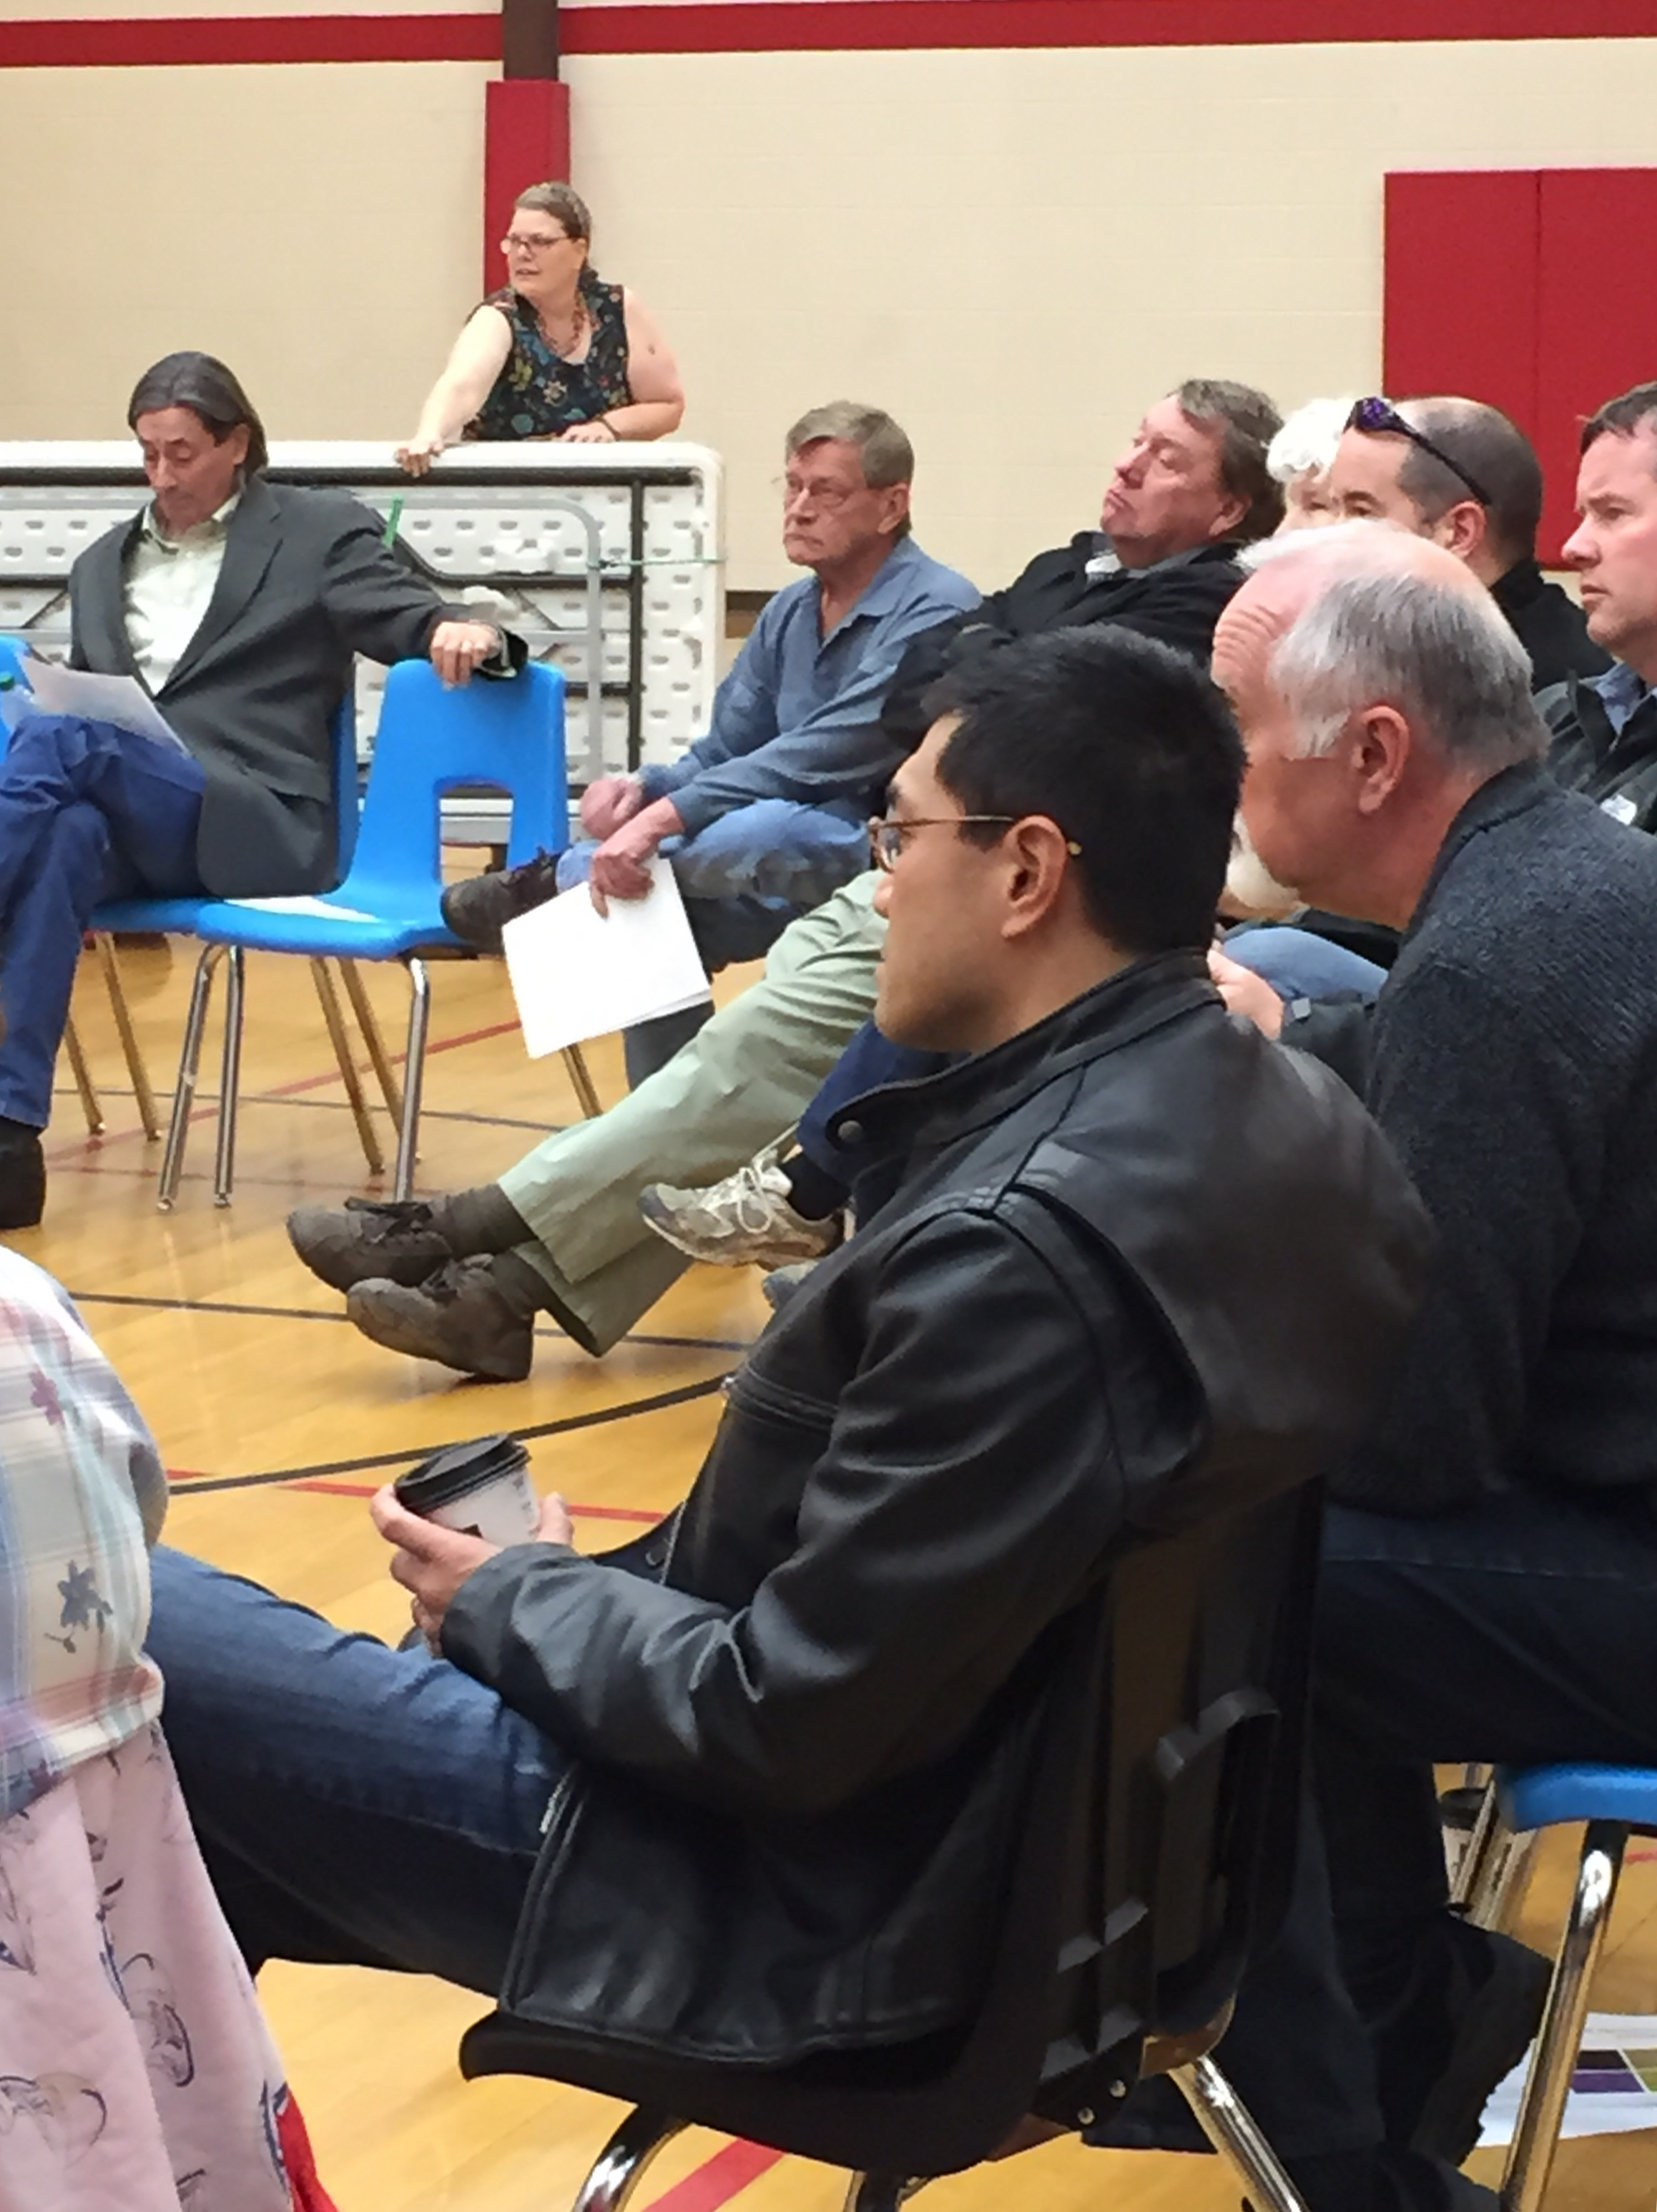
Public Involvement

Slide 7
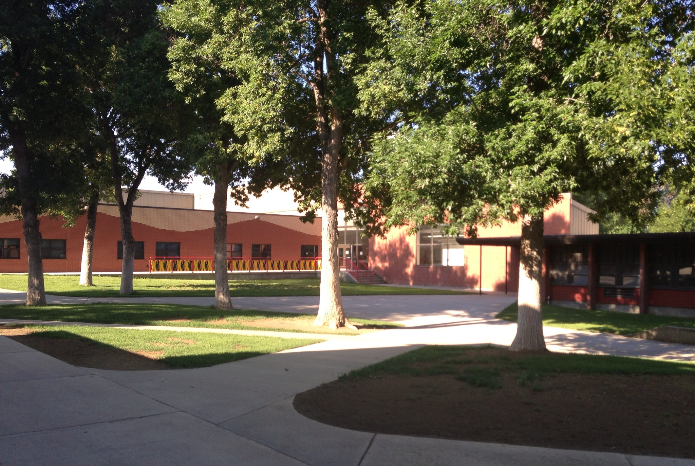
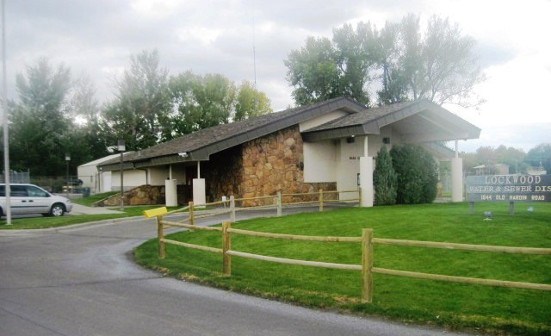
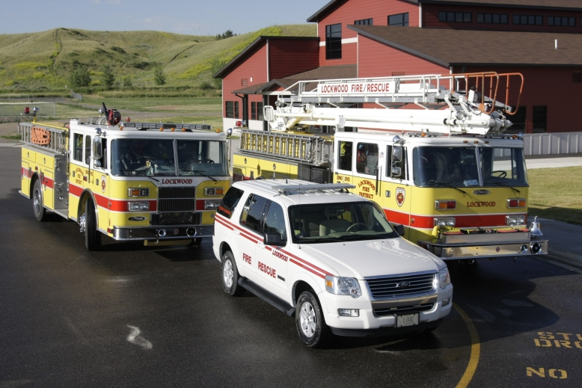
Meetings Held
County Commission presentations in September, 2014 and January, 2015
Presentation and Site Tour for Property Owners and other interested parties in January
Three public meetings in January and February in Lockwood
Presentations to the Lockwood School Board and the City-County Planning Board in January
Two meetings with the Utilities Working Group
Two meetings with Taxing Jurisdictions

Slide 8
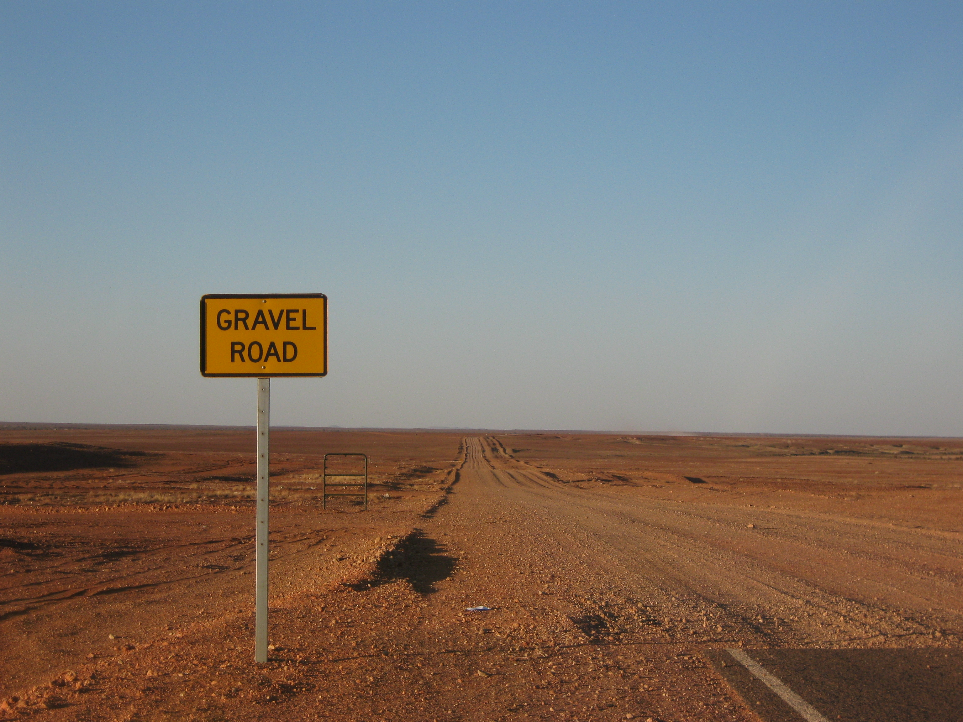
Infrastructure Deficiencies Studied
Based on information provided by:
Utilities Working Group representing
Water and Sewer District
Public Utilities
NWE
MDU
YVEC
MDT
Pedestrian Advocates
Public Safety Personnel
County Staff
Property Owners
Professional Engineers
Taxing Jurisdictions

Slide 9
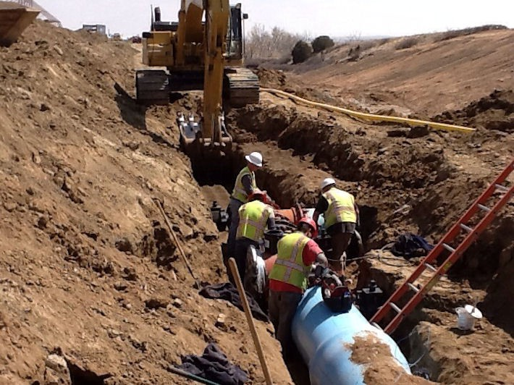
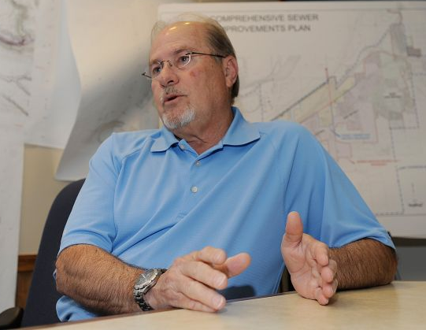
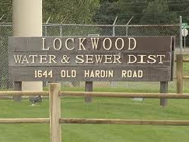
Infrastructure Deficiency Findings
Water System – A public water system is not available in the area.
Sewer System – A public sewer system is not available in the area.

Slide 10
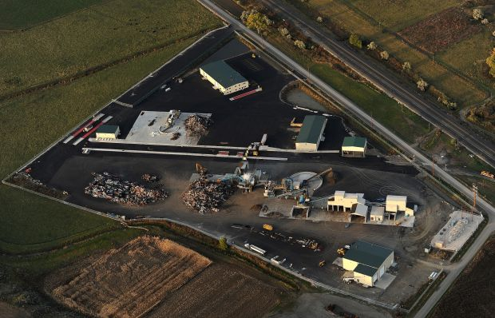
Findings (Continued)
Transportation – Both on- and off-site transportation upgrades, including rights-of-way, will be required. Rail trans-loading facilities are not available.
Utilities – Heavy load industrial users would require supply, transmission line and substation expansions and redundancy.
Aerial Photo of Pacific Steel & Recycling’s Lockwood campus.

Slide 11
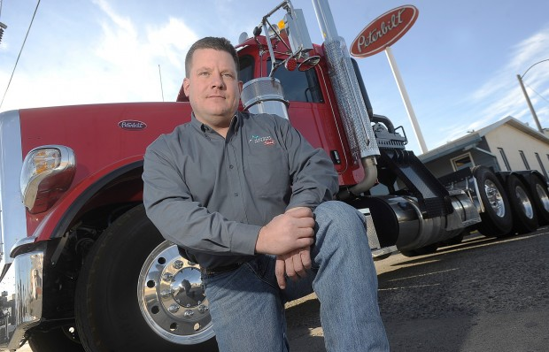
Findings (Continued)
Broadband Connectivity – Broadband services are available in close proximity but would require extension.
General Improvements – Additional infrastructure and public service deficiencies will be identified over time.
“Of the many challenges we faced with the move to this area, none was greater than the infrastructure, or the lack thereof.”

Slide 12
Public Infrastructure Needed to Support Trailhead Commerce Park
Off-site Road Improvements
$ 6,412,000
Off-site Wastewater Improvements
$ 4,342,000
Off-site Water Improvements
$ 3,625,000
*Assumes build out
*A phased infrastructure investment approach will be needed and will be articulated as a part of the Comprehensive Development Planning process in Phase II.

Slide 13
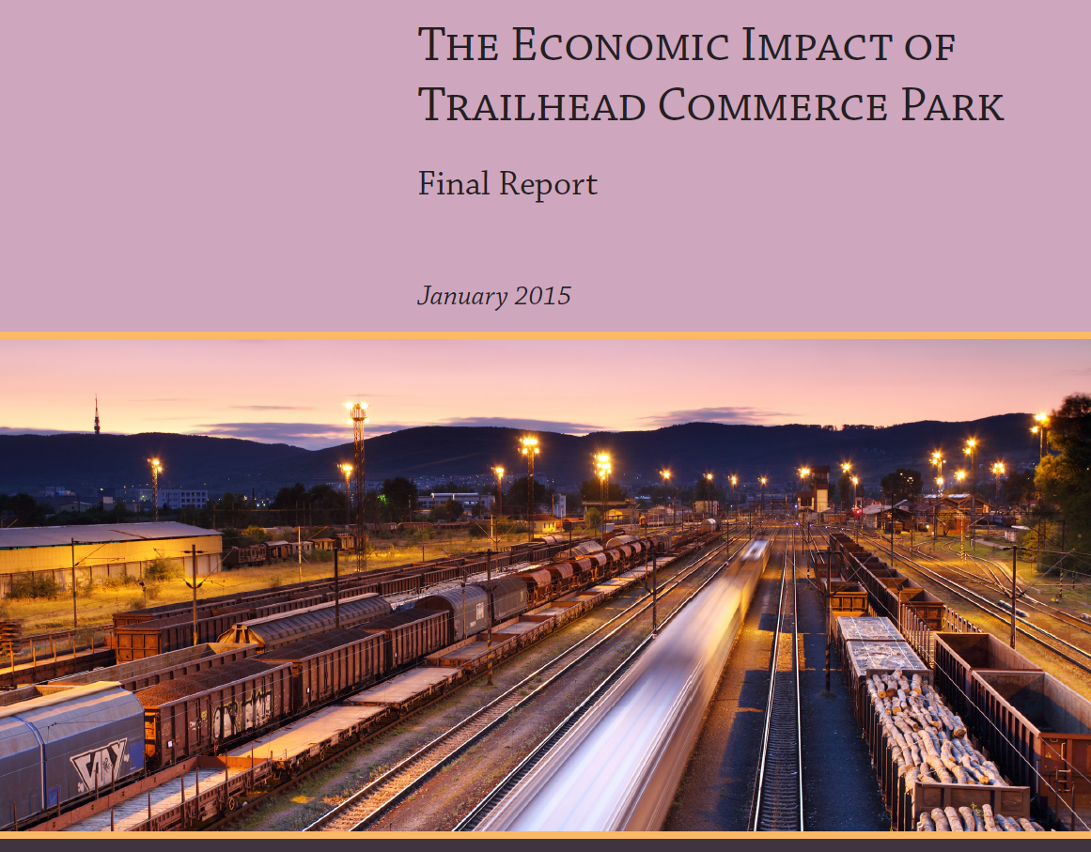

Slide 14
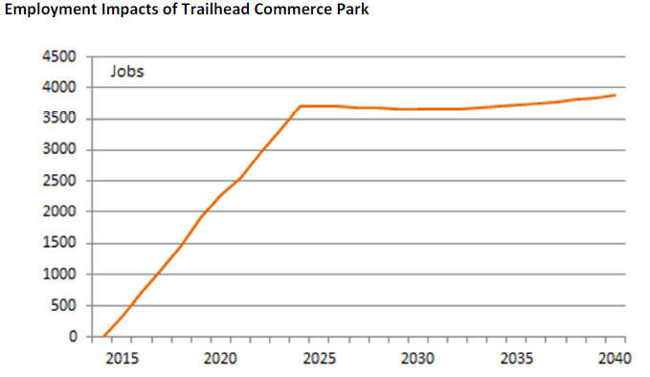
Trailhead Commerce Park: Economic Impact
3,655 jobs
$255.7 million in recurring annual household income
$862 million in recurring, annual gross sales
$61.2 million in tax and non-tax revenue that flow to state government

Slide 15
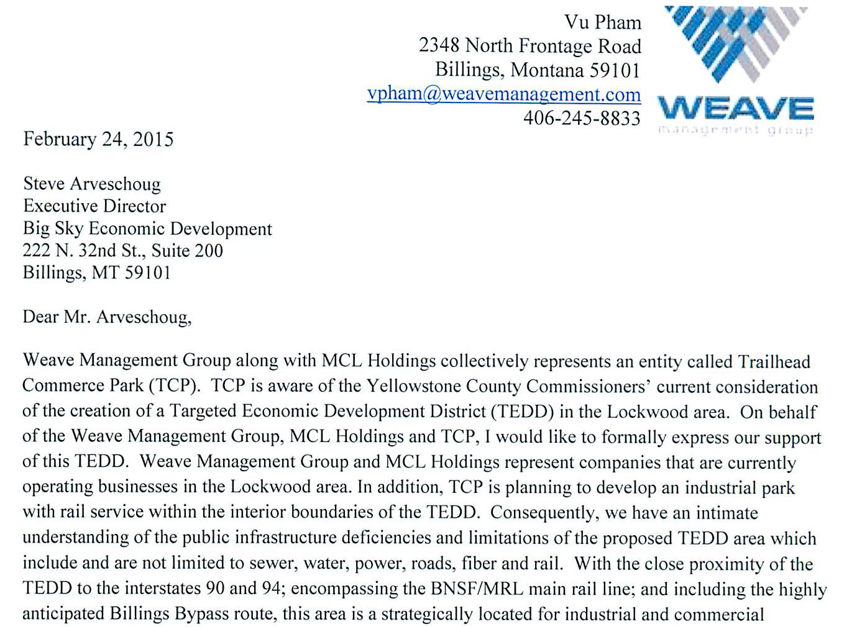

Slide 16
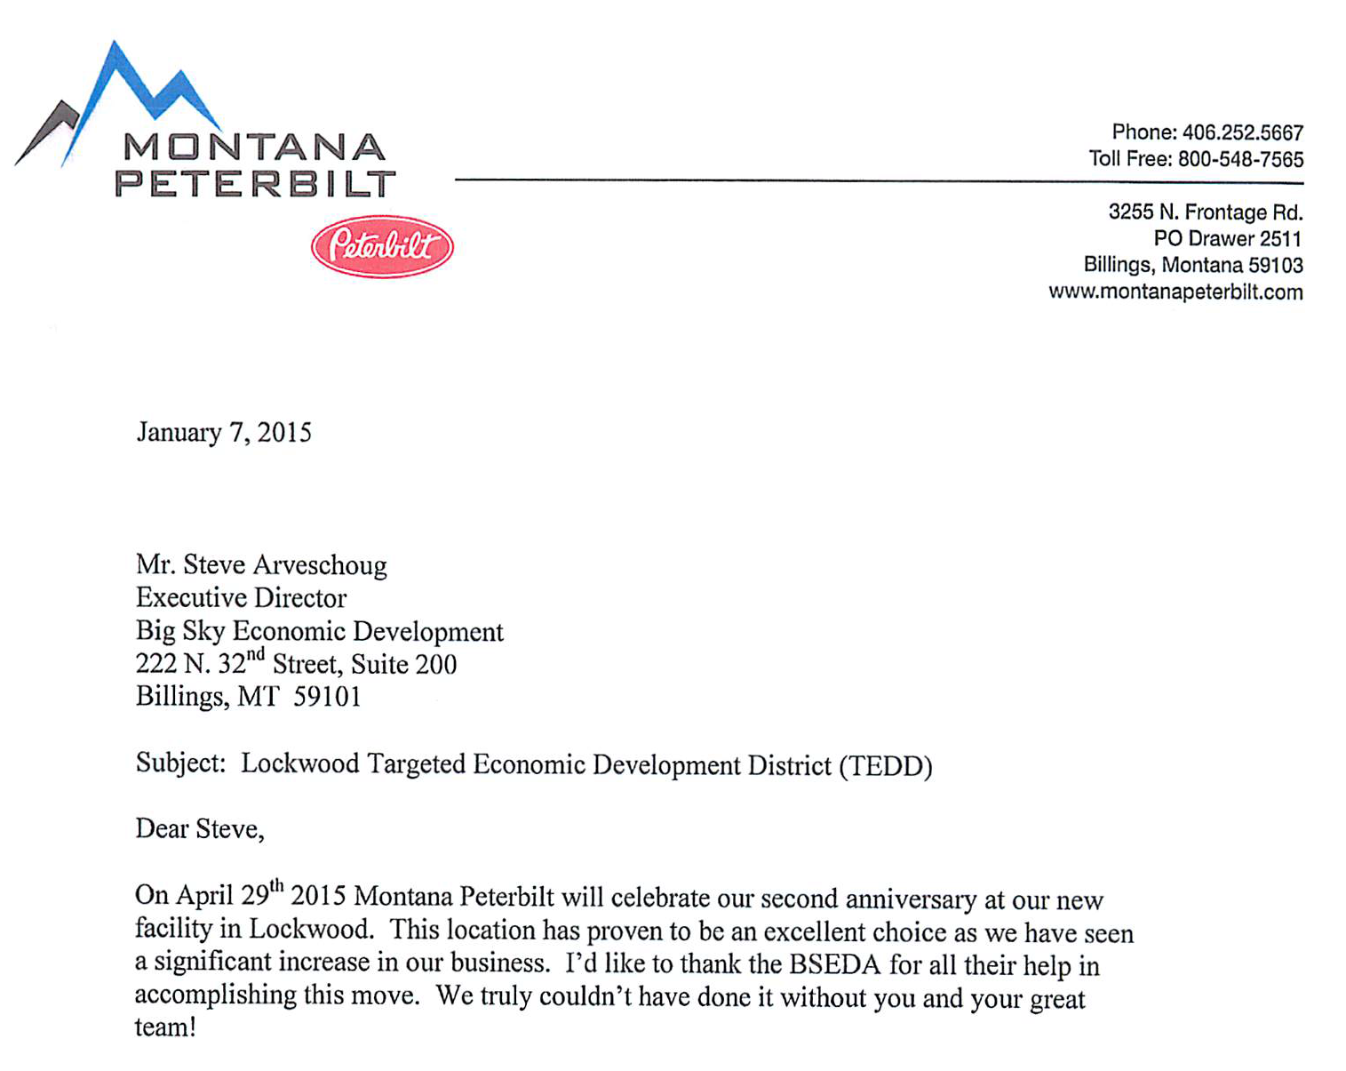

Slide 18
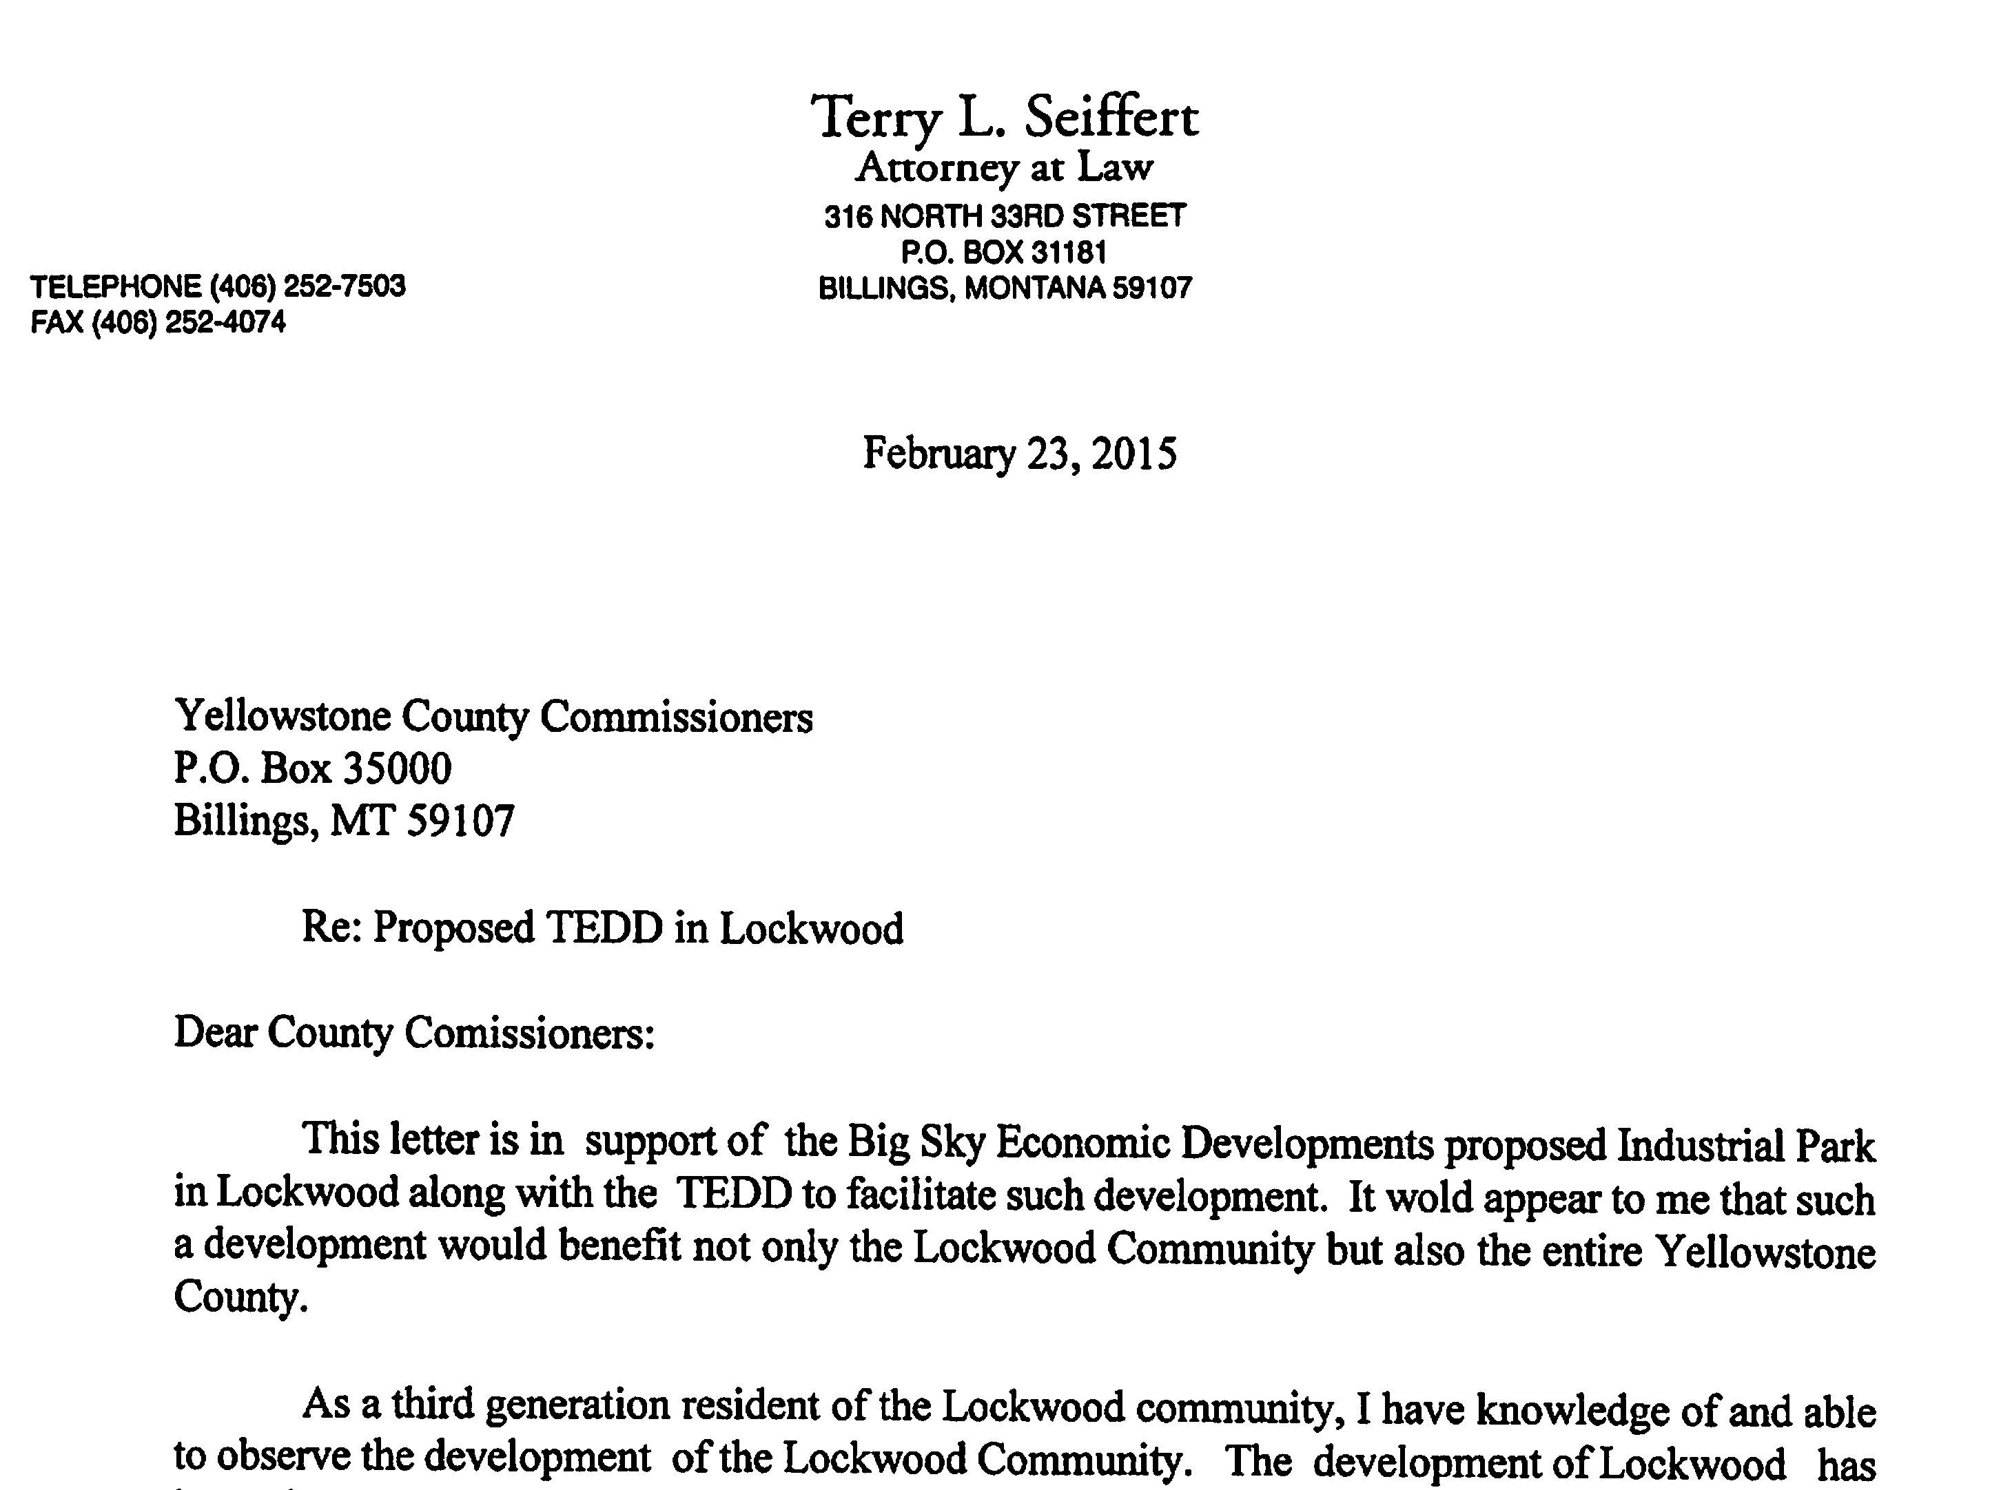

Slide 20
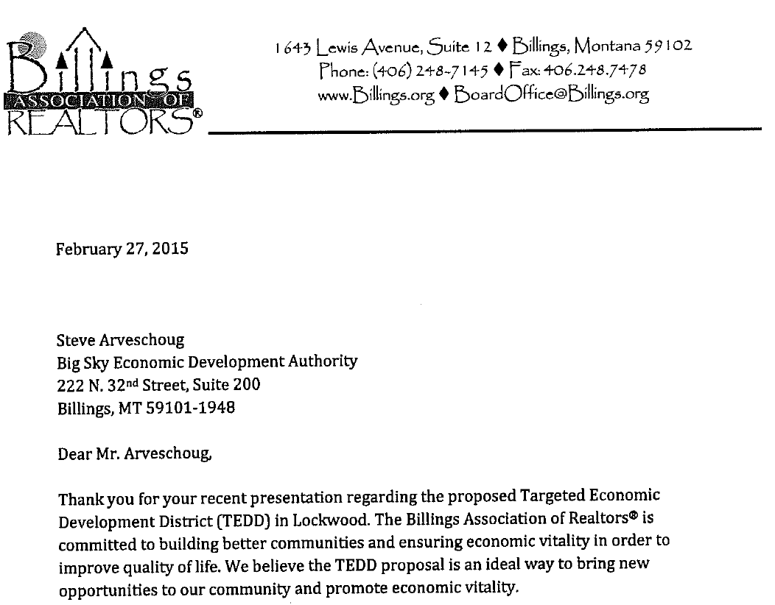

Slide 21
Today’s Action – Consideration and public comment on the adoption of the Resolution of Necessity
Resolution of Necessity With Statement of Infrastructure Deficiency
Adoption of the Resolution DOES NOT create the TEDD.
Adoption does enable the County through BSED to move on to Phase II
The creation of the TEDD will only occur, at a later date, if the Commission adopts a Comprehensive Development Plan by Ordinance after Planning Board review and a public hearing.

Slide 22
Resolution of Necessity 7-15-4280 MCA
Resolution of necessity required for targeted economic development district. A local government may not exercise the powers provided in part 43 or this part unless it has adopted a resolution of necessity finding that: (1) one or more infrastructure-deficient areas exist in the local government; and (2) the infrastructure improvement of the area is necessary for the welfare of the residents of the local government.

Slide 23
NEXT STEPS
Phase II

Slide 24
Steps in Creating a TEDD Phase II
Preparation of a Comprehensive Development Plan that includes:
Projects and Programs
A TIF Provision
Program Management
Zone map amendment for the TEDD area.
Recommendation by the Planning Board as to whether the Comprehensive Development Plan for the TEDD is in conformance with the Growth Policy and the District is zoned in accordance with the Growth Policy.

Slide 25
Phase II Steps Continued
Publication of notice, and notification by mail of all property owners in the district of the required public hearing.
Consideration and public hearing on the Ordinance creating the TEDD and adopting the TEDD Comprehensive Development Plan.
Submittal of a certified copy of the TEDD adoption documents to the Montana Department of Revenue (7-15-4284 MCA) and all other affected taxing bodies no later than February 1st, 2016.

Slide 26
Our Commitment
Open, inclusive process
Community-driven
Steering Committee
Consistent and timely status reports
Responsive to questions and concerns
Community outreach www.lockwoodtedd.com

Slide 27
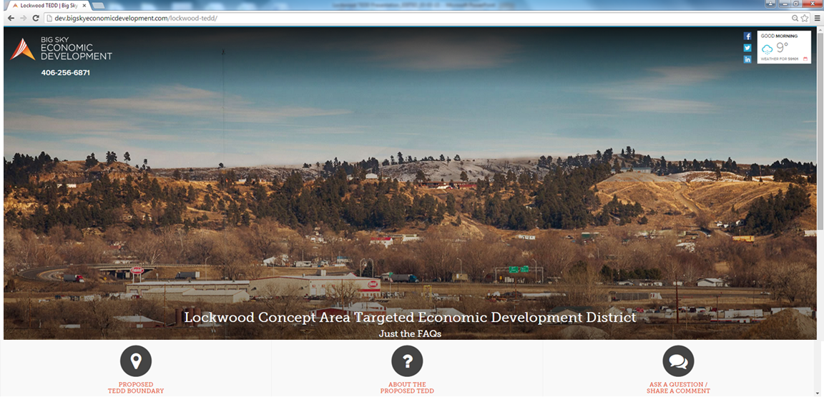
www.LockwoodTEDD.com
What is a TEDD and what is the process?
What roles will the different entities play?
Where will TEDD monies be spent?
Who’s going to pay for public infrastructure?
Who will manage the project?
How will the Bypass affect the industrial park?
Where will the employees come from?
Traffic, Road Improvements, Pedestrian Safety

Slide 28
Conclusion
Create planned, ready-to-go industrial space
Support existing industry
Address challenges of growth
Opportunity for new business recruitment

Slide 30
Public Comment

